Slide 1
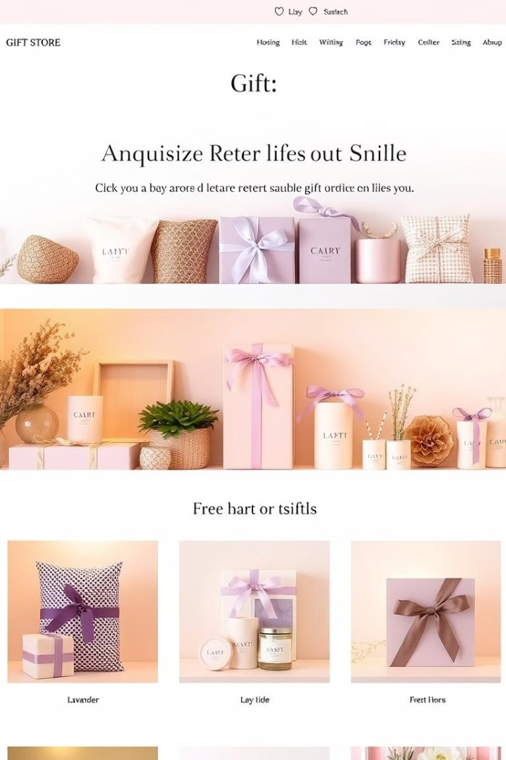
Launching Your Online Gift Store: A Sweet Opportunity
E-commerce provides low overhead and global reach. This is an opportunity to curate unique, personalized gifts beyond mass-market options.
R.Manish Vedanayagam

Slide 2

Identifying Your Niche & Target Audience
1
Define Your Category
2
Define Your Customer
Focus on a specific gift type. Consider personalized, sustainable, or gourmet gifts.
Consider demographics, interests, and purchasing habits.
3
Example
Eco-conscious millennials seeking sustainable gifts. Millennials are 35% of online gift buyers.
75% of consumers prefer personalized gifts. 50% value sustainability.

Slide 3
Curating a Compelling Product Catalog
Source Unique Gifts
Visual Appeal
Customization
Source high-quality gifts that align with your niche.
Focus on products with strong visual appeal for online presentation.
Offer customization options to increase perceived value.
80% of consumers will pay more for personalized products. Example: Artisan candles with custom scents.

Slide 4
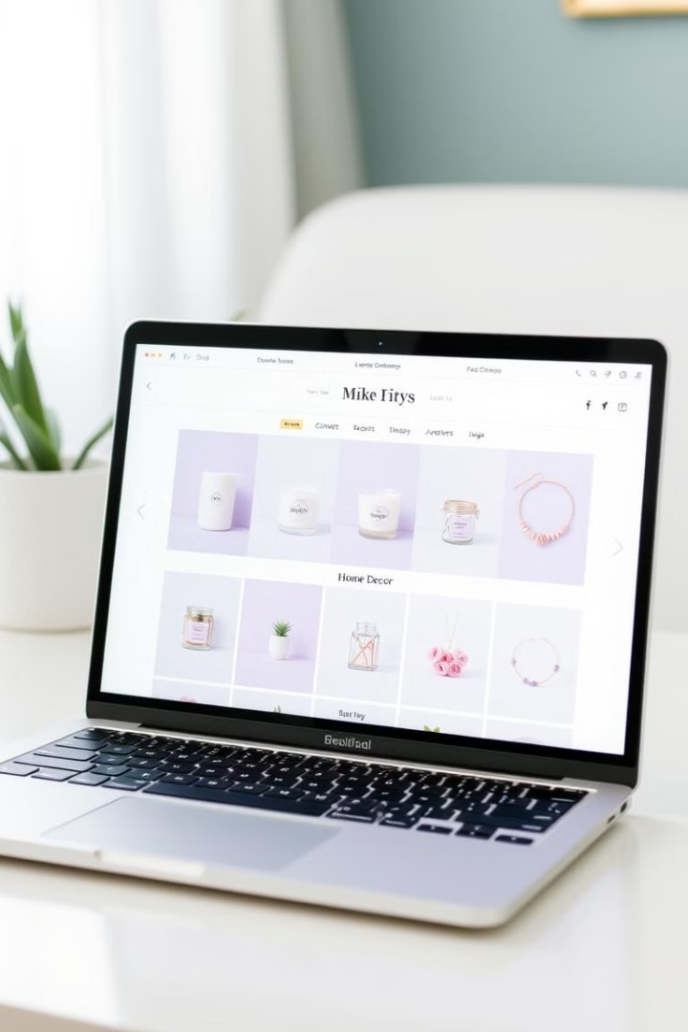
Building Your Ecommerce Platform
Choose Platform
User-Friendly
Select the right platform like Shopify or Etsy, or a custom website.
Prioritize easy navigation and mobile responsiveness.
Product Photos
Use professional shots from multiple angles.
Website load speed is key; 53% abandon sites taking over 3 seconds to load.

Slide 5




Crafting a Winning Marketing Strategy
SEO
Social Media
Email
Improve search engine rankings.
Use Instagram, Pinterest, and Facebook.
Build an email list to nurture leads.
The average ROI for email marketing is $42 for every $1 spent.

Slide 6




Delivering Exceptional Customer Service
Prompt Support
Streamlined Shipping
Personalized Comm
Offer customer support via email, chat, and phone.
Ensure smooth order fulfillment and shipping.
Use personalized communication to build loyalty.
70% of buying experiences are based on customer treatment. Loyalty programs are key.

Slide 7
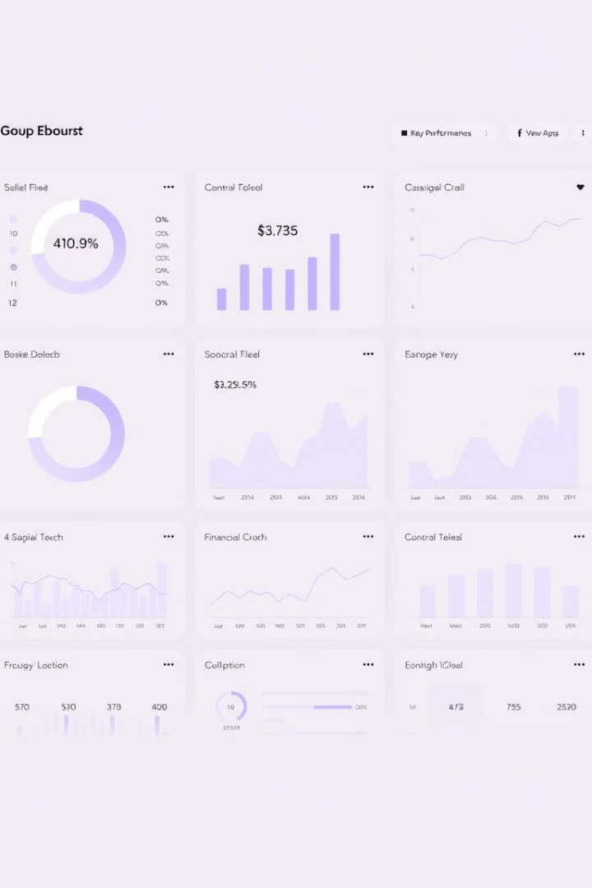
Financial Projections & Key Metrics
1-3%
$42
Conversion Rate
Email ROI
The average e-commerce conversion rate.
Average return on investment from emails.
95%
E-commerce by 2040
Projected percentage of purchases online.
Consider startup costs, revenue projections, and profitability analysis.

Slide 8

Conclusion: Turning Gifts into Gold
The online gift market provides opportunities for entrepreneurs. Success requires a niche, products, and marketing. Customer service is critical for building loyalty.
By 2040, it is estimated that 95% of all purchases will be via eCommerce.

